Slide 1
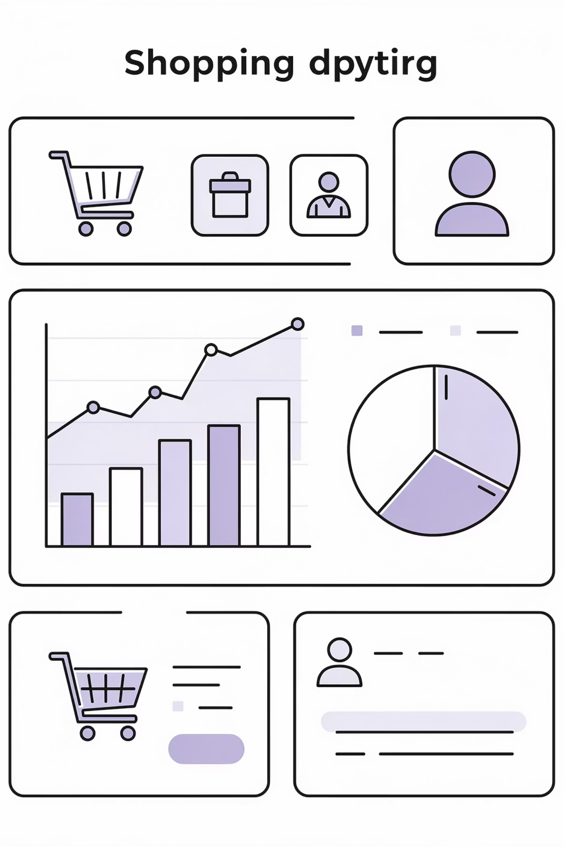
Machine Learning for E-Commerce Analytics
Sentiment Classification and Customer Churn Prediction
MSc Data Analytics – Data Mining & Machine Learning ModuleNational College of IrelandDecember 2025

Slide 2

Introduction & Business Context
The E-Commerce Challenge
Research Objectives
Compare ML methods across text and structured e-commerce datasets
The global e-commerce sector generates unprecedented volumes of customer data daily. Two critical business challenges emerge: understanding customer sentiment at scale and predicting customer churn before it occurs.
Apply CRISP-DM methodology systematically
Implement model interpretability using SHAP and LIME
Identify key business predictors for actionable insights
This comparative analysis applies machine learning methods to address both challenges, delivering automated review monitoring and proactive retention strategies.

Slide 3
Datasets Overview
Amazon Fine Food Reviews
E-Commerce Customer Churn
Type: Text data
Type: Structured data
Size: 500,000+ reviews
Size: 5,630 customers
Target: Sentiment (3-class)
Target: Churn (Binary)
Analysis: Natural language processing for customer opinion classification
Analysis: Behavioural pattern recognition for retention strategies
Both datasets represent real-world e-commerce scenarios, enabling comparative evaluation of ML algorithms across different data types and business applications.

Slide 4






Methodology: CRISP-DM Framework
Data Understanding
Business Understanding
EDA, distributions, imbalance analysis
Define customer analytics objectives
Data Preparation
TF-IDF, SMOTE, feature scaling
Evaluation
Multiple metrics, interpretability
Modelling
4 ML algorithms implemented
Text Processing Pipeline
Structured Data Pipeline
TF-IDF vectorisation (5,000 features)
SMOTE for class imbalance
Bigram extraction
Feature scaling & normalisation
Sentiment mapping (1-5 stars)
20 behavioural features

Slide 5
Amazon Reviews Sentiment Analysis
01
02
03
Dataset & Task
Preprocessing
Models Compared
Classify 500,000+ Amazon food reviews into Positive, Neutral, and Negative sentiment categories using star ratings (1-2: Negative, 3: Neutral, 4-5: Positive)
TF-IDF vectorisation extracting 5,000 features with bigrams to capture phrase-level sentiment patterns and contextual meaning
Naive Bayes (baseline probabilistic approach) versus SVM (kernel-based classification for high-dimensional text data)
Model
Naive Bayes
SVM
Accuracy
75.6%
78.9%
F1-Score
73.8%
78.2%
Cohen's Kappa
0.524
0.598
Key Finding: SVM outperforms Naive Bayes across all metrics. LIME analysis reveals sentiment-driving words: "love", "excellent", "delicious" (positive) versus "disappointed", "terrible", "waste" (negative).

Slide 6
Customer Churn Prediction
01
02
03
Business Problem
Data Preparation
Key Features
Predict which customers will churn from 5,630 customer profiles with 20 behavioural features, addressing 17% class imbalance
SMOTE synthetic sampling to balance classes, feature scaling for numeric variables, encoding of categorical predictors
Customer tenure, satisfaction score, complaint history, order frequency, payment preferences, and engagement metrics
Model
Random Forest
XGBoost
Accuracy
86.2%
87.5%
ROC-AUC
89.2%
90.8%
Precision
84.1%
85.7%
Key Finding: XGBoost achieves superior performance. SHAP analysis identifies tenure as the strongest predictor, with complaints increasing churn risk and satisfaction scores reducing it significantly.

Slide 7


Model Interpretability
LIME: Text Sentiment
SHAP: Churn Prediction
Positive Indicators
Top Churn Predictors
"Excellent" – strong quality signal
Tenure: Newer customers at highest risk
"Perfect" – satisfaction marker
Satisfaction Score: Lower scores predict churn
"Delicious" – taste approval
Complaints: Each complaint increases risk 23%
"Recommend" – advocacy intent
Order Frequency: Declining activity signals disengagement
Negative Indicators
"Terrible" – quality failure
"Waste" – value disappointment
"Disappointed" – unmet expectations
Business Value: LIME reveals product quality issues from review language, whilst SHAP identifies at-risk customer segments for targeted retention campaigns.

Slide 8
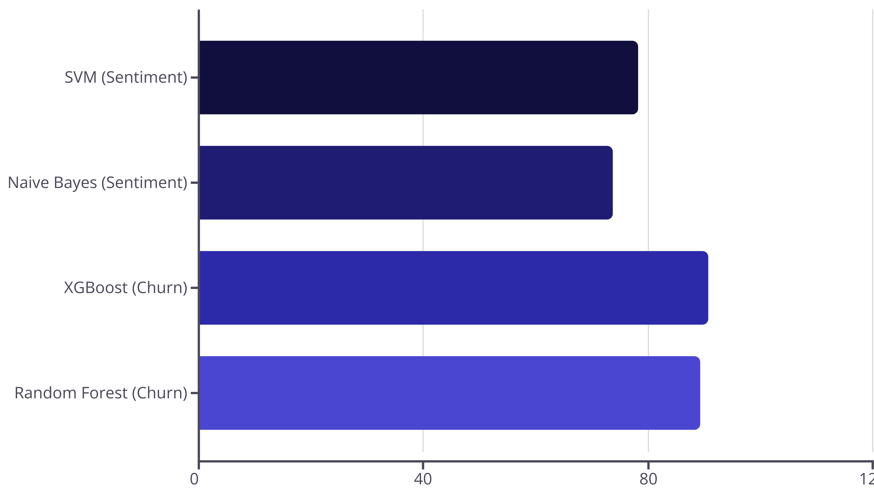
Model Comparison & Key Findings
Text Classification Winner
Churn Prediction Leader
SVM demonstrates superior performance for sentiment analysis with F1-score of 0.782, effectively handling high-dimensional TF-IDF features
XGBoost achieves highest ROC-AUC of 0.908, leveraging gradient boosting for structured behavioural data patterns
Ensemble Advantage
Imbalance Solution
Random Forest and XGBoost excel on structured data, whilst kernel methods dominate text classification tasks
SMOTE effectively addresses class imbalance, improving minority class detection without sacrificing overall accuracy

Slide 9




Business Implications & Conclusions
Automated Review Monitoring
Proactive Churn Prevention
Deploy SVM models to categorise thousands of product reviews automatically, enabling real-time quality alerts and rapid response to negative sentiment trends
Implement XGBoost scoring to identify high-risk customers, triggering personalised retention campaigns before disengagement occurs
Resource Optimisation
Product Improvement
Focus marketing budgets on likely churners, achieving 3-5× ROI improvement through targeted intervention strategies
Extract actionable insights from negative reviews using LIME interpretability to guide product development and quality control
Key Conclusions & Future Directions
Research Conclusions
Future Research
SVM recommended for sentiment classification
Deep learning (BERT) for nuanced text analysis
XGBoost optimal for churn prediction
Real-time scoring systems deployment
CRISP-DM effectively structured analysis
A/B testing of retention campaigns
Interpretability drives business adoption
Multi-modal data integration

Slide 10
Questions Welcome
Thank You
We appreciate your time and attention. This comparative analysis demonstrates the practical application of machine learning methods to solve critical e-commerce business challenges.
Acknowledgements
National College of IrelandMSc Data Analytics ProgrammeData Mining & Machine Learning Module Faculty
Key References
CRISP-DM Methodology Framework
Lundberg & Lee (2017): SHAP Values
Ribeiro et al. (2016): LIME Interpretability

